Slide 1
Continuous Integration and Delivery

Slide 2
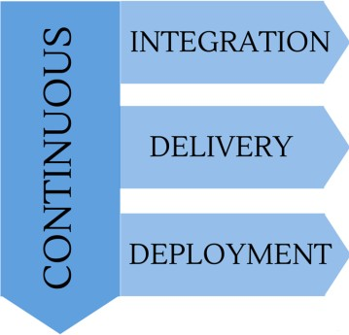
Continuous Integration, Delivery and Deployment
Continuous Integration is a software development practice where members of a team integrate their work frequently; usually each person integrates at least daily – leading to multiple integrations per day.” --Martin Fowler
Continuous Delivery is a software development discipline where you build software in such a way that the software can be released to production at any time” --Martin Fowler
Continuous Deployment is a third term that’s sometimes confused with Continuous Delivery. Where Continuous Delivery provides a process to create frequent releases but not necessarily deploy them, Continuous Deployment means that every change you make automatically gets deployed through the deployment pipeline.

Slide 3
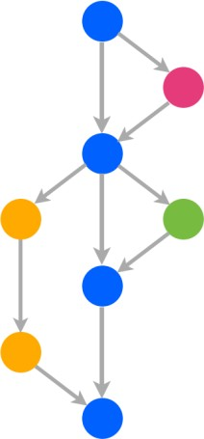
Overview
Workflow
Two long running branches “master” and “develop” with a transient number of feature branches
Using “GitHub Flow”
Development Workflow (continued)
External workflow:
Create a feature branch off of the develop branch and commit changes
Create a “pull request” (PR) targeting the development branch
Merge PR after it passes CI tests and team review
Delete feature branch after integration is complete
External workflow:
Create a fork of the Working repository and create feature branch
Commit changes to the feature branch
Create a “pull request” (PR ) targeting the development branch
Merge PR after it passes CI tests and team review
Delete feature branch after integration is complete
Continuous Integration
Using CircleCI: https://circleci.com/
CircleCI integrated with GitHub via Webhooks
Any commits, merges or pull requests trigger the CI pipeline
Repo is automatically built, run and tested on CircleCI
Merges to Master and Develop branches create and register deployable containers
Passing CI tests on Master and Develop branches trigger deployment

Slide 4
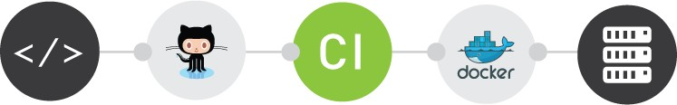
Continuous Deployment
Circle CI triggers deployment services defined in Docker Cloud service
Docker Cloud service pulls new container image from registry and deploys it to AWS
The deployment is sequential so only one application server is updated at a time
Event Notification
Slack pushes notifications to smart phones
STTR team notified of every CI event (pass or fail)
Notifications of service redeployments
Notifications of service health / recovery status

Slide 5
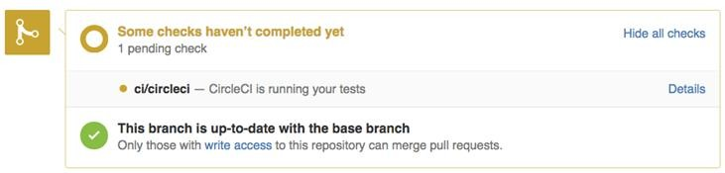
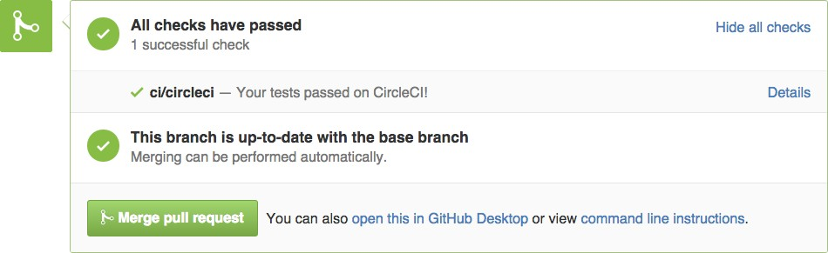
CI and SCM Integration
Pull request status while CI testing is in progress:
Pull request status after CI testing is complete; ready to merge without fear

Slide 6
End to End Deployment process

Slide 7
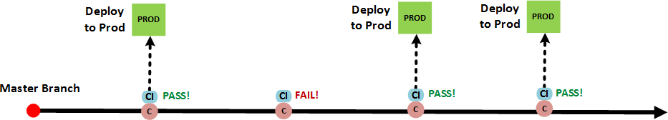











Single environment
Single branch
Continuous deployment
Docker Hub
CircleCI
3
7
1
2
Git
GitHub
4
6
Amazon AWS
5
8
Docker Cloud
Slack

Slide 8








Continuous Integration Tool Options
Solution | Site | SCM Support
Travis CI | https://travis-ci.org | GitHub
Circle CI | https://circleci.com | GitHub
CodeShip | https://codeship.com | GitHub, Bitbucket
Drone.io | https://drone.io | GitHub, Bitbucket
Shippable | https://app.shippable.com | GitHub, Bitbucket
Appveyor | http://www.appveyor.com | GitHub, Bitbucket, VSTS (visual studio online)
Distelli | https://www.distelli.com | GitHub, Bitbucket
Jenkins | https://jenkins.io/ | SVN, GitHub, Bitbucket, CVS, Perforce, TFS, …
Jenkins

Slide 9
CI & CD Principles
Automate everything: build, test and deployment
Keep everything in a source code management system (use GitHub)
Keep absolutely everything in a source code management system
Use a CI tool that integrates tightly (webhooks) with your source code repository
Commit your code to the repository frequently
Don’t commit directly to a delivery branch; use a feature branch and PR workflow
Don’t ignore failing CI tests even on feature branches
Don’t merge broken code to a delivery branch; it must pass the CI system first
Deploy the same way to every environment
No-downtime deployments; stateless frontend, load balancer and sequential deployment
Automated feedback on the entire process
Use a container technology (Docker) if possible as makes deployment simple
If the process is painful, you’re doing it wrong

